Slide 1
Lecture 1
Brandon Moe

Slide 2
Introduction
LabVIEW is a visual based programming language used in manufacturing and is very easy to learn.
The best way to learn LabVIEW is to get onto a computer and start playing around with it. Get familiar with it.

Slide 3
Todays Lesson
LabVIEW Basic Terms
Different data types
Boolean Comparison
Loops / Cases

Slide 4
LabVIEW Basics

Slide 5
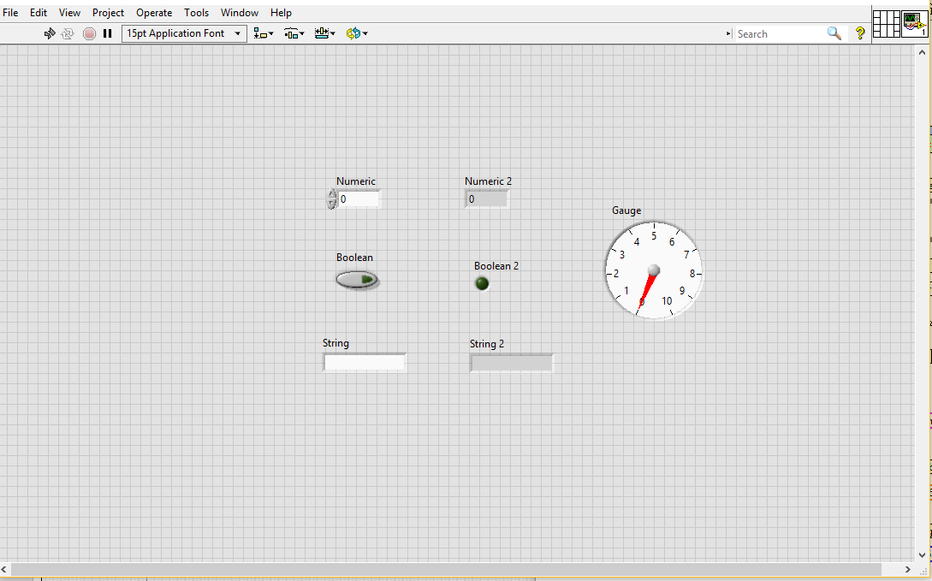
Front Panel

Slide 6
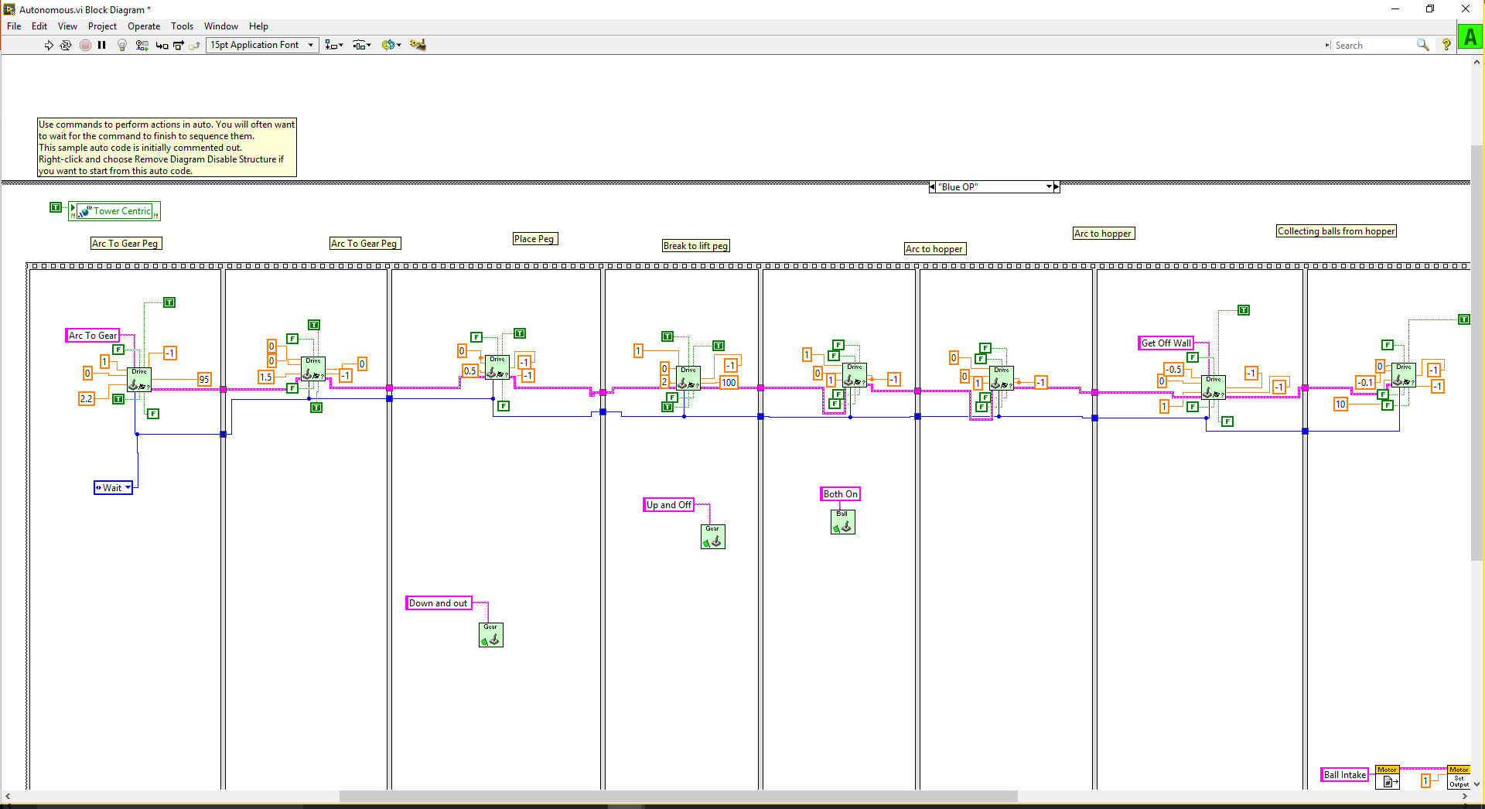
Block Diagram

Slide 7
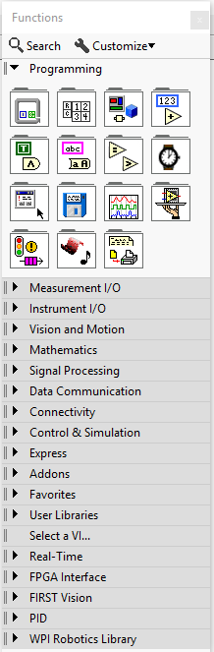
LabVIEW Pallet
Every LabVIEW function can be found here
Used to write code
Right click to bring up pallet

Slide 8
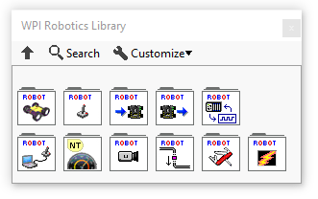
WPI Robotics Library
This is where you can find everything robotics related in LabVIEW
Located under the LabVIEW Pallet
Ex: joystick, motors, Talon SRX, pneumatics

Slide 9
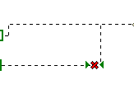

Broken Wires
Broken wires, indicated by dashed lines, means your program will not work.
It is also indicated by a broken run arrow

Slide 10
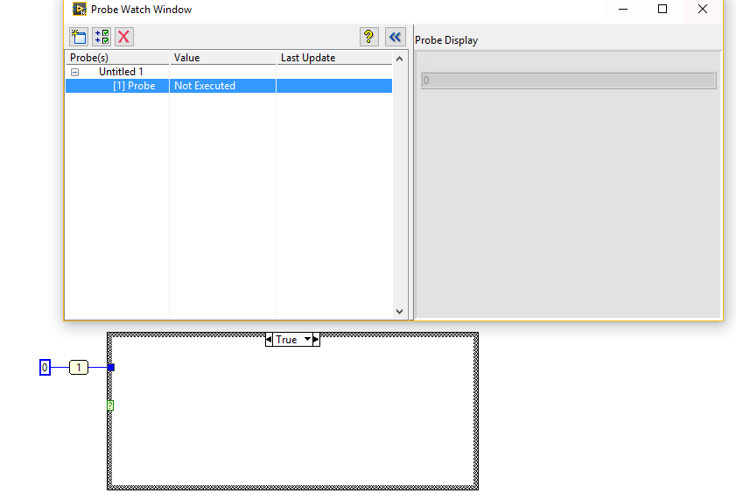
Probe
Used at runtime to see values at given point

Slide 11

Breakpoint
Used for Troubleshooting code
Will run the program to this point and then stop

Slide 12
Memory Leak
If a program gets stuck in a while loop or if a for loop never ends.
This can happen if you put a while loop inside of a while loop.

Slide 13
Commenting code
ALLWAYS COMMENT YOUR CODE!!!!
REMEMBER TO COMMENT YOUR CODE.
DID YOU COMMENT YOUR CODE?
If anything could ever be misinterpreted in your code, comment it

Slide 14
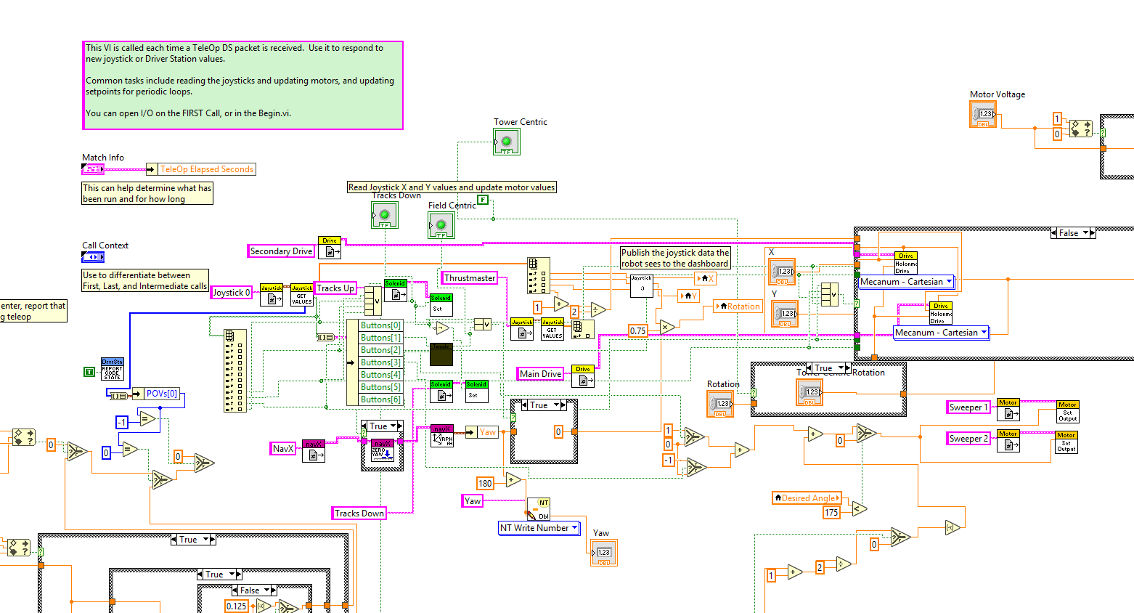
Spaghetti code
2016 Competition Code

Slide 15
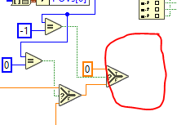
Terminating Points
Program section ends
Uses CPU to run this section
Slows your code down

Slide 16
LabVIEW Keystrokes to know
C-e: goes between front panel and block diagram
C-b: cleans up any broken wires
C-u: cleans up the highlighted code
Be carful with this one
C-S-n: pulls up the navigation window
Very helpful in big code
C-l: error list
C-z: undo
C-mouse: moves whole program

Slide 17
Data Types

Slide 18
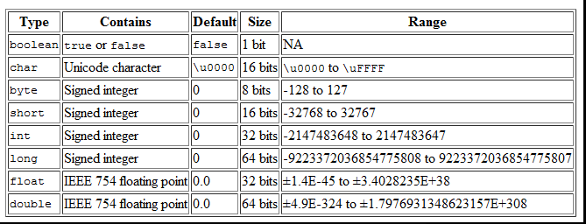
Data Types

Slide 19
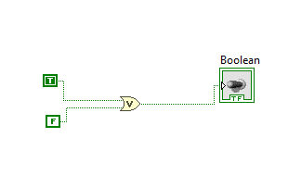
Boolean
True or False values
Used for comparison
Represented by a green line in LabVIEW

Slide 20
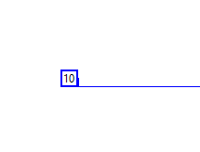
Integer (int)
Integers are represented by blue in LabVIEW
Standard LabVIEW int is a long (32 bit)
Range is -2147483648 to 2147483647
INTEGERS CAN NOT BE DECIMALS!!!!!!!
EX: 10 -7 11.2

Slide 21

Double
Most common data type used
64 bit
Has a max range of ~15 digits
This can be a decimal value
Represented in LabVIEW by Orange
Also allows for all mathematical values like Pi, e, infinity, log

Slide 22
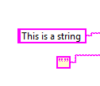
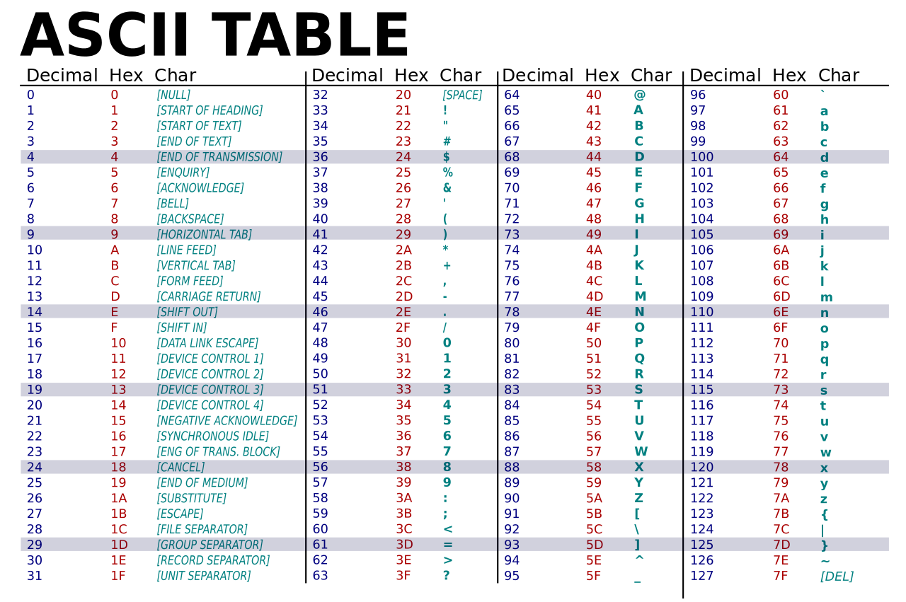
String
Used to represent text in programs.
Program reads text in ASCII format

Slide 23
Array
Array
0
1
2
3
4
5
6
7
Used for joystick buttons
Start at 0
Can hold any data type
Places in array are known as “Array Index x”

Slide 24
Boolean Comparison

Slide 25
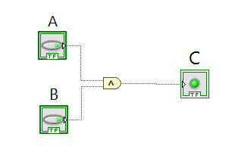
And Gate
A | B | C
0 | 0 | 0
0 | 1 | 0
1 | 0 | 0
1 | 1 | 1

Slide 26
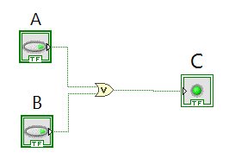
Or Gate
A | B | C
0 | 0 | 0
0 | 1 | 1
1 | 0 | 1
1 | 1 | 1

Slide 27

Not Gate
A | C
0 | 1
1 | 0

Slide 28
Data Manipulation

Slide 29
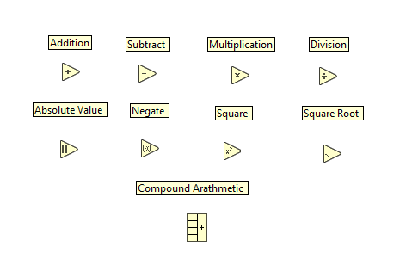
Double Output

Slide 30
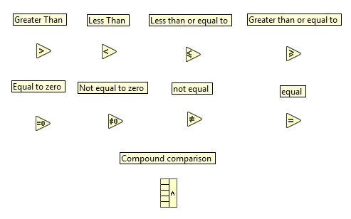
Boolean Output

Slide 31
Loops and Structures

Slide 32
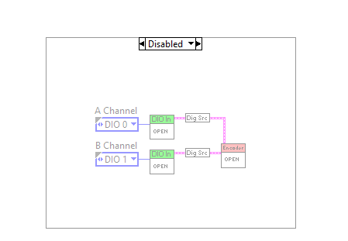
Disable Structure
The section of code within this will not run

Slide 33
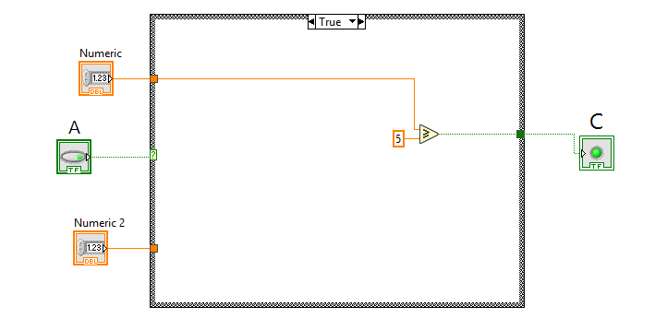
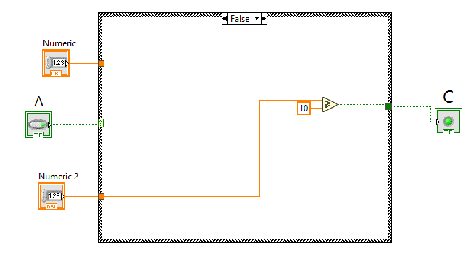
Case Structure
Requires a Boolean input
If A is true it runs the true case, If A is false it runes the false case

Slide 34
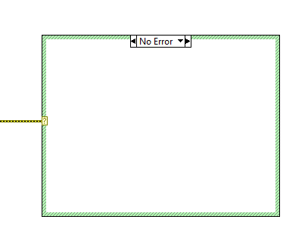
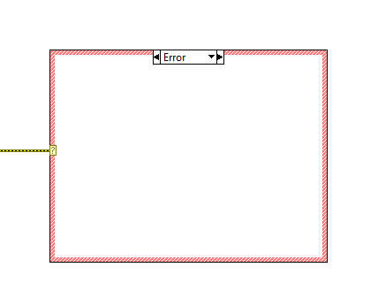
Case Structure with Error input

Slide 35
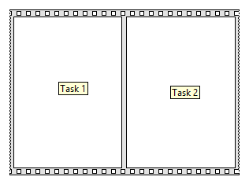
Flat Sequence
Does events in order
Commonly use in autonomous

Slide 36
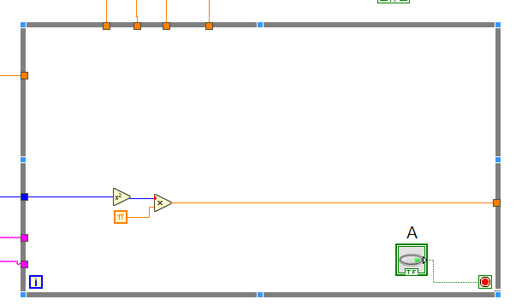
While Loops
This type of loop will repeat itself until the condition (A) becomes false.
Example of this is teleop

Slide 37
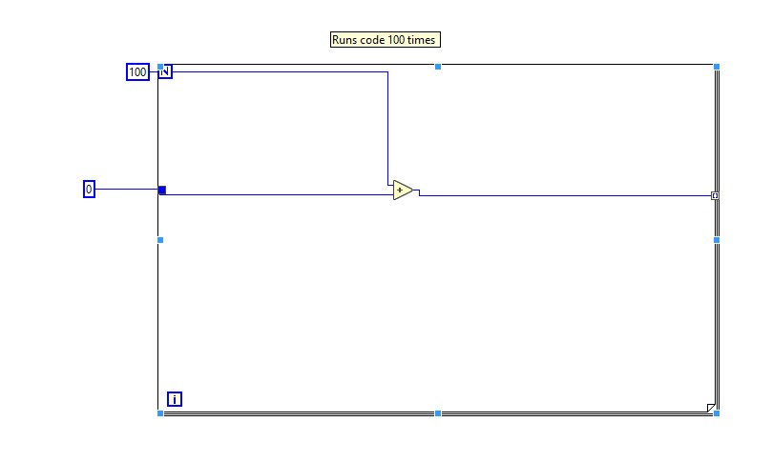
For loop
This loop will run N times
Useful if something needs to run a certain number of times

Slide 38
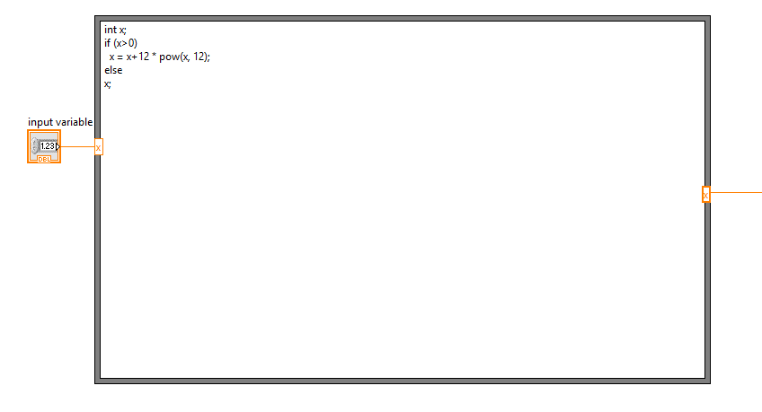
Formula Node
This is used to integrate C or C++ code into a LabVIEW program

Slide 39
Key Terms
Boolean
Int
Long
Double
While Loop
Case Structure
Flat sequence
Teleop
Autonomus
Periodic Tasks
And
Or
Nor

Slide 40

Lab 1
Write a VI that will take a int that is the diameter of a circle, and with a Boolean control, switches the calculation from area of a circle to volume of sphere. Code must be commented.
Hint:
Area of circle, π*r^2
Volume of sphere = (4/3)*π*r^3
Pi in Labview
X^2 in Labview
One point extra credit if you use compound arithmetic

Slide 41
Turn In procedure
Make a folder called extra VI’s
Name VI Lab 1

